Slide 1
Act I scene II
Amjed Lateef Jabbar
Ph.D. in English Literature

Slide 2
The Scene functions as an introduction to the play.
It highlights the contrast between scene 1 and scene 2.
It presents the similarities between Hamlet and Fortinbras in terms of; kingdom, lost fathers, and revenge.

Slide 3
This scene focuses on 3 questions:
A: why is Claudius king, not Hamlet?
B: how can Claudius mourn and smile at the same time?
C: are Claudius and Gertrude guilty of incest and adultery?

Slide 4
Hamlet’s witty pun (line 67) “I am too much in the sun” which carries three possible meanings: son (3 times), sun (melancholy), and a very dedicated son to his father.
At this stage in the play, Hamlet is hurt by and angry at his mother because he thinks that she shamed him and the memory of his father, so he is trying to shame her.
Hamlet is poetic and idealistic in soul, thus he is now shocked (everything SEEMS), nothing is as he thought it to be.

Slide 5
First soliloquy in the play, line 254 (dramatic irony), it tells 3 things about Hamlet:
1. the extent of his disturbance even before the appearance of the ghost.
2. his fury and shock at his mother.
3. the crux of his melancholy (the world in chaos, all feels wrong).

Slide 6
Hamlet embodies all the features of melancholy:
1. he despises life.
2. he wishes he were dead.
3. he feels that he has no control over his own self nor his surroundings.
To make it worse, he must be silent: he cannot change it, but cannot accept it.

Slide 7
this scene shows Hamlet’s enthusiasm and happiness for seeing Horatio (lord, sponsor?).
The exchange between Hamlet and Horatio is an example of Stichomythia:
It is the technique in which two actors deliver speech in alternating lines.
It functions as: 1. emphasizing the significance of what is discussed, and, 2. the scene gains force and excitement from it.

Slide 8
As usual in Shakespearean drama, the scene ends in suspense.

Slide 9
Text specific remarks:
1. line 62, king says to Laertes
Take thy fair hour, Laertes; time be thine,
And thy best graces spend it at thy will.
But now, my cousin Hamlet, and my son, ------
2. line 65, Hamlet says an Aside?
3. line 140, a mythological allusion to Hyperion Vs. Satyr.

Slide 10
4. line 146, Hamlet says “Frailty, thy name is woman.”
5. line 149, a mythological allusion to Niobe.
6. line 153, a mythological allusion to Hercules.
7. lines 244-245, Hamlet’s exaggerations (a man of words?).

Slide 11
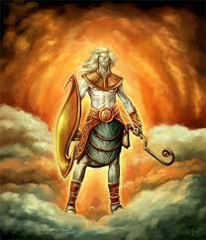

Slide 12
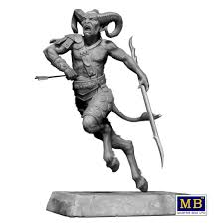

Slide 13
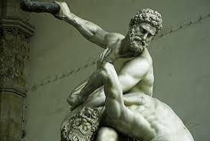

Slide 14
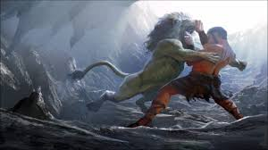

Slide 15
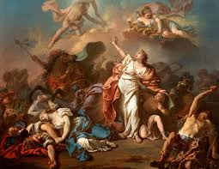

Slide 16
