Slide 1
2.10.Types of sentence Structure: 2.11 Element realization types
CHAPTER 2

Slide 2
2.10
Types of sentence Structure:
Basic sentence-structure types : refers to Patterns of the Sentence Elements:
These are basic sentence patterns of all possible sentence structures.
Most simple sentences in English follow one of these sentence patterns as shown in the examples below.

Slide 3
it is essential to recognize and use the various sentence parts that make up the pattern of English sentences. These sentence parts occur in several basic formats.
The order in which these sentence elements/parts appear is common but not fixed.
we present rules of these pattrens diagrammatically constitutes a pattern of elements .
A technique known as diagramming is used to visualize the pattern of a sentence. Diagramming involves discovering and displaying the internal structure of a sentence.

Slide 4
1.Subject + verb. The simplest of sentence patterns is composed of a subject and verb without a direct object or subject complement. It uses an intransitive verb, that is, a verb requiring no direct object:
S +Verb :stat intens
2.Subject + linking verb + subject complement. Another simple pattern uses the linking verb, any form of the to be verb without an action verb:
S + Verb :stat intens + Cs
3.Subject + verb + direct object. Another common sentence pattern uses the direct object:
S + V (dyn/stat)(trans) mono:Od
4.Subject + verb + indirect object + direct object. The sentence pattern with the indirect object and direct object
S + V (dyn/stat)(trans) di(Oi)Od
5.Subject + verb + direct object + object complement. The sentence pattern using the [direct object] and object complement
S + V (dyn/stat)(trans)complex :Od Co

Slide 5
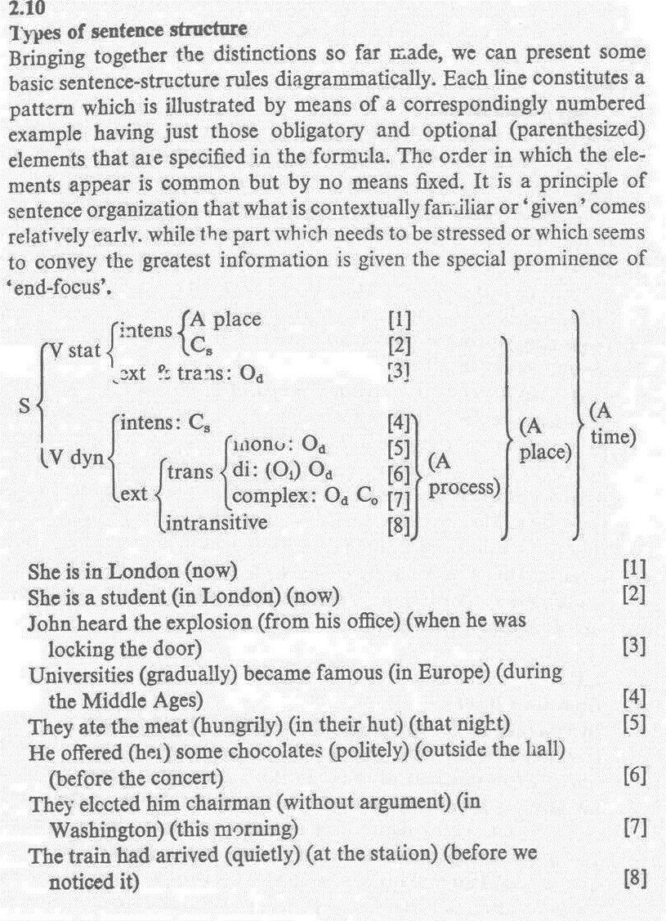

Slide 6
2.11 Element realization types
Sentence elements are realized by linguistic structures of very different form.
relates to constituents in a sentence.
The sentense element is composed of what?
the predicate part
The structures realizing the verb element is always a verb phrase
the verb phrase is one headed by a verb. It may be composed of only a single verb, but typically it consists of combinations of main and auxiliary verbs
Verb phrase consists of
1.one word or
2.more than one word
The head in a VP is a VERB.
The main verb can be preceded by auxiliaries. (by one or more auxiliary verbs)

Slide 7
Verb phrases:
'finite' (showing tense, mood,aspect and voice) verb phrase
Simple finite VP: present and past
Verb: finite Complex (progressive and perfective)
Complex Finite VP
Complex Finite VP
Non finite VP
Simple Finite VP

Slide 8
or 2.'non-finite‘ verb phrase
'non-finite' verb phrase (not showing tense or mood but still capable of indicating aspect and voice)
1.Infinitive (simple VP)
2.(to + infinitive( simple VP)
3. Complex VP(-ing participle and –ed participle)
Examles:
Simple :non finite
Mary wanted to be(v) a student (c) at that university (A)(o)
Complex non finite :-ing participle
Carefully (A) searching (v) the room (o), (A) John found a ring.(o)
Complex non finite :-ed participle
Made(v) the chairman(c) every year(A),(A) he was very busy.

Slide 9
Subject Element is realized by :
1.Clause
That [she (S) answered (v) the question (O) correctly (A)] (S) pleased (V) him (O) enormously (A) [9]
2.Noun Phrase The subject consists of a Head Noun with its modifiers 3. Pronoun She is a student at a large university.
4. Proper Noun
5.Noun phrase = Long & Complex= Noun as Head preceded by one or all the following Items:

Slide 10
1.Articles
2. Adjective
3.Another Noun Followed by a prepositional phrase
4.Relative clause
Example
Noun as Head preceded by modifier adj.)
The new gas stove (NP) in the kitchen(PP) which {I bought last month (Relative clause)} (S) has a very efficient oven.

Slide 11
Direct Object realized by:
Noun phrase:noun phrase NP:modifier +N :as head
EX:
He had given the girl an apple.
Clause:Od operates and functioning as a clause in noun clauses(that,what,etc)
Proper noun
Pronoun EX:She made him happy
Indirect objects,
their realizations are chiefly
noun phrases
Pronoun
He had given the girl an apple. noun phrase NP:modifier +N :as head
the girl =NP:an+noun

Slide 12
Subject complements and object complements
may be realized by structures as
1.Noun phrases
2. Adjectival phrases (having an adjective as head):
3.clause
She made him happy Od Co
very much happier

Slide 13
Finally, adverbials can be realized
by adverb phrases, having an adverb as head;
(a) John very carefully searched the room.
(b) by noun phrases;
(b) They make him the chairman every year.
(c) by prepositional phrases —that is, structures consisting of a noun phrase dominated by a preposition;
(c) She studied at a large university.
and
(d) by clauses, finite :
(d) He grew happier when {his friend arrived}.
or non-finite:
Seeing the large crowd, John stopped his car.

