Slide 1
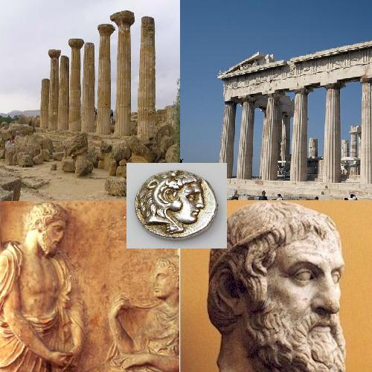
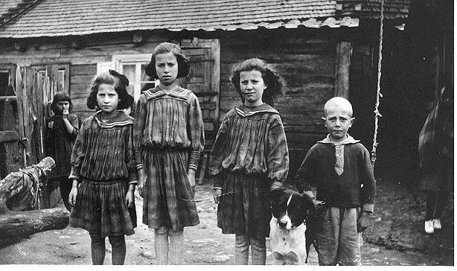
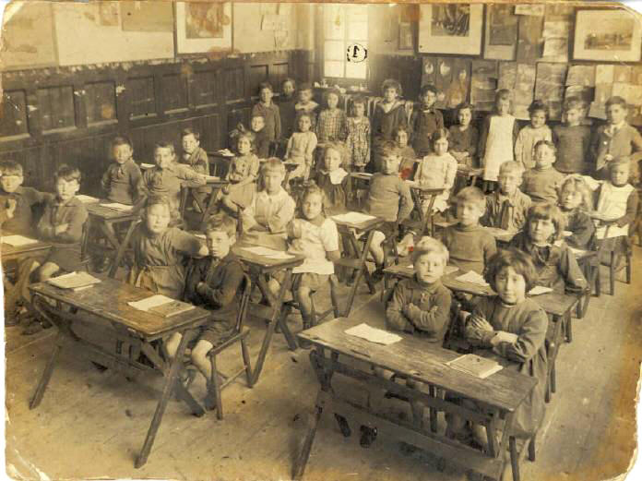
THE GRAMMAR TRANSLATION METHOD
PREPARED BY :
IFFAH MARINAH JOHAARI
ALINA ZAKARIA
Teaching by Principles ☺

Slide 2
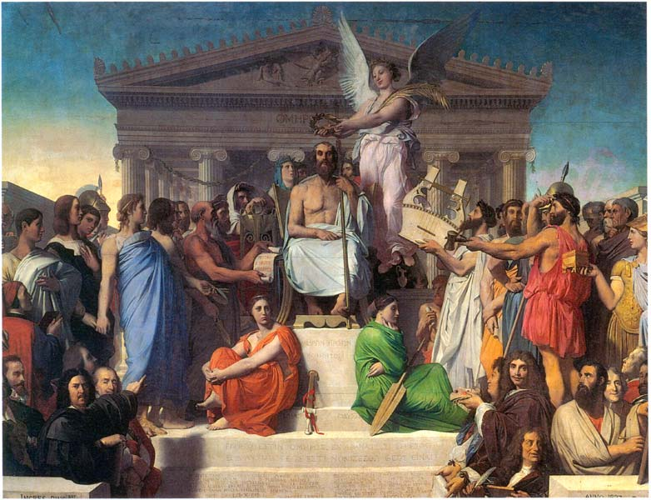

The Grammar Translation Method of Teaching English
The grammar-translation method is a method of teaching foreign languages derived from the classical method of teaching Greek and Latin
Late 19th and early 20th centuries
It was essentially based on the use of L1(mother tongue) and L2(target language)

Slide 3
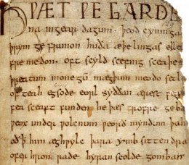

The method has two main goals:
To enable students to read and translate literature written in the target language
Develop student’s general mental discipline.

Slide 4



Translation is the key to this methodology as is reading and writing. There is not normally any listening or speaking practice carried out moreover, there is virtually no pronunciation practice for the students.

Slide 5

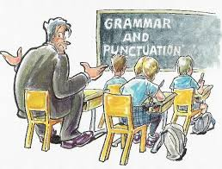
MAJOR CHARACTERISTICS OF GRAMMAR TRANSLATION
1. Classes are taught in the mother tongue, with the
little active use of the target language :
*which means the teacher will teach the target
language using the mother tongue of the
students
*For Malaysian we are going to use Malay
language

Slide 6
MAJOR CHARACTERISTICS OF GRAMMAR TRANSLATION
2. Much vocabulary is taught in the form of lists of
isolated words
*Isolated words is the word that is not connected
to each other
* Vocabulary items are taught in the form of
word list

Slide 7

MAJOR CHARACTERISTICS OF GRAMMAR TRANSLATION
3. Long, elaborate explanations of the intricacies of
grammar are given
* The teacher will explain details about the
grammar rule in the simple grammar table
* for example, in teaching of the Subject Verb
Agreement

Slide 8
MAJOR CHARACTERISTICS OF GRAMMAR TRANSLATION
4. Grammar provides the rules for putting words
together, and instruction often focuses on the form
and inflection of words
*which means the grammar rules provide us
the way to construct sentences in a proper way,
to give instructions to form and says the word
properly

Slide 9
*For example the grammar rule will guide us to
pronounce words using correct pronunciation
- We will pronounce the word read as read
when the action word in the present tense
whereas we will pronounce the word read as
read when the action word is in the past tense

Slide 10
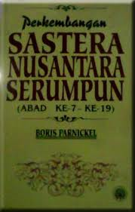

MAJOR CHARACTERISTICS OF GRAMMAR TRANSLATION
5. Reading of difficult classical texts is begun early
*The teacher will expose to students with the
literature text which is classical text earlier
*In Malay, we call it as Kesusasteraan Melayu

Slide 11
MAJOR CHARACTERISTICS OF GRAMMAR TRANSLATION
6. Little attention is paid to the content of texts, which
are treated as exercises in grammatical analysis
*Which means the student will only have to read
the passage and identify the grammar rules
which is related to SVA
*They do not have to understand what is the
passage is all about

Slide 12

MAJOR CHARACTERISTICS OF GRAMMAR TRANSLATION
7. Often the only drills are exercises in translating
disconnected sentences from the target language
into the mother tongue
*This means that the teacher will drill the students
with a lot of exercises that contains sentences in
English and the students must translate the
sentences into their mother tongue

Slide 13
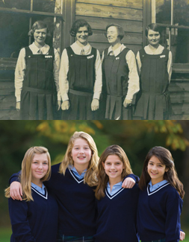
MAJOR CHARACTERISTICS OF GRAMMAR TRANSLATION
8. Little or no attention is given to pronunciation
*The teacher will not emphasize on the way the
students should pronounce the words

Slide 14
MAJOR CHARACTERISTICS OF GRAMMAR TRANSLATION
Teacher
Source of knowledge
Students
Passive

Slide 15

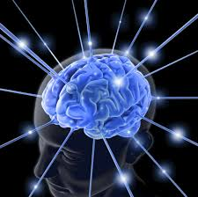
Pros and Cons
Advantages:
Focusing the translation of Vocabularies-beginners
Good for mental exercises.

Slide 16




Disadvantages:
Class time is not allocated for students to produce their own sentences
less time is spent on oral practice (whether productive or reproductive)

Slide 17


Removes any creativity from the class-dull and bored.
Often little contextualization of the grammar
Difficult to describe the actual meaning

Slide 18
TIME FOR ACTIVITies!
Terjemahkan ayat ini ke dalam bahasa ibunda anda.
I am a student
Irsyad is a good boy
Shikin is drinking a cup of coffee
Syira loves her father

Slide 19
CiteD from websites
http://en.wikipedia.org/wiki/Grammar-translation_method
References
Chastain, Kenneth. The Development of Modern Language Skills: Theory to Practice. Philadelphia: Center for Curriculum Development,1971.
Rippa, S. Alexander 1971. Education in a Free Society, 2nd. Edition. New York: David McKay Company, 1971.
Richards, Jack C.; Rodgers, Theodore S. (2001). Approaches and Methods in Language Teaching (2nd ed.). Cambridge, New York: Cambridge University Press.
Rivers, Wilga M. Teaching Foreign Language Skills, 2nd Edition. Chicago: University of Chicago Press, 1981.
http://blog.about-esl.com/grammar-translation-method-teaching-english/
http://www.japantoday.com/category/opinions/view/the-grammar-translation-method-is-it-really-all-that-bad
http://www.nthuleen.com/papers/720report.html

Slide 20
Textbook and video
Prator and Celce-Murcia (1979,p.3) chapter 2 A “Methodical” History of Language Teaching. Teaching by Principles, An Interactive Approach to Language Pedagogy. Third Edition, H. Douglas Brown
http://www.youtube.com/watch?v=bO14GvgOXfM The Grammar Translation Method GTM

Slide 21
THE END ! ☺

