Slide 1
Shopping Listening and speaking second stage Assistant Lecturer Dhuha I Khalil
University of Dayala
College of education for human sciences

Slide 2
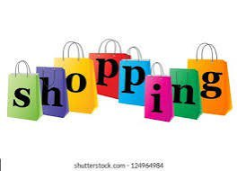
Shopping Terms
Shopping is a common activity, but it can be confusing with all the different terms used. This presentation will cover essential shopping terms to help you navigate the world of retail.

Slide 3
Types of Stores
* Department store: A large store with various departments selling different products.
* Supermarket: A large self-service store selling groceries and household items.
* Boutique: A small store selling fashionable clothing or accessories.
* Specialty store: A store that specializes in selling a particular type of product.
* Online retailer: A store that sells products online.

Slide 4
Shopping Actions
* Browse: To look at products without intending to buy.
* Compare: To check the prices of different products before buying.
* Purchase: To buy a product.
* Return: To take a product back to the store for a refund or exchange.
* Exchange: To replace a product with another one.

Slide 5
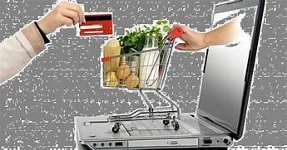
Payment Methods
* Cash: Physical money.
* Credit card: A card that allows you to borrow money to make purchases.
* Debit card: A card that allows you to pay for purchases directly from your bank account.
* Gift card: A card with a pre-loaded amount of money that can be used to make purchases.
* Mobile payment: Paying for purchases using a mobile device.

Slide 6
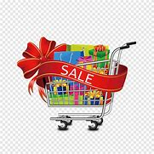
Discounts and Promotions
* Sale: A temporary reduction in the price of a product.
* Discount: A percentage or fixed amount reduction in the price of a product.
* Coupon: A voucher that entitles the holder to a discount.
* Promotion: A marketing activity that encourages customers to buy a product.
* Clearance: A sale of products that are no longer in demand.

Slide 7
Other Important Terms
* Warranty: A guarantee that a product will be free from defects for a certain period of time.
* Receipt: A written record of a purchase.
* Customer service: The assistance provided to customers before, during, and after a purchase.
* Loyalty program: A program that rewards customers for their repeat business.
* Price tag: A label that shows the price of a product.

Slide 8
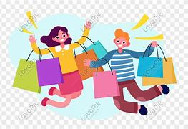
Conclusion
Understanding these shopping terms will make your shopping experience easier and more enjoyable. Happy shopping!

