Slide 1
Unit Three
HOME

Slide 2
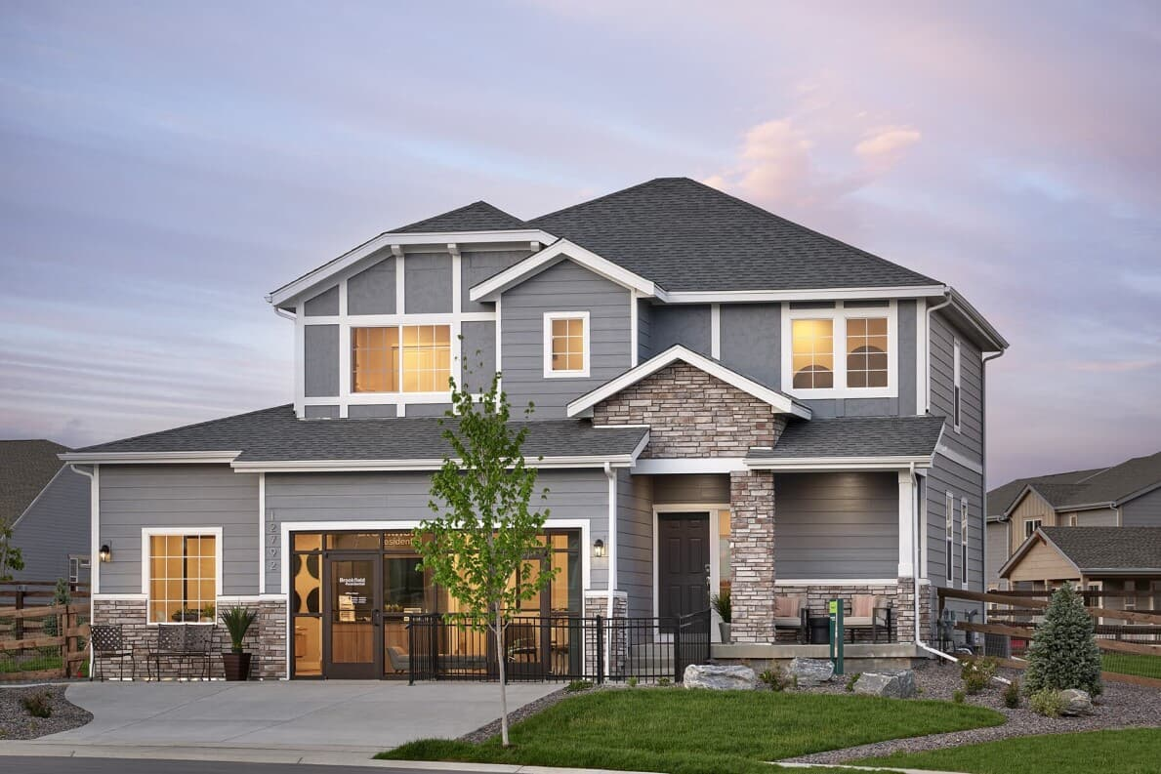

Slide 3
- How would you describe “Home”?
Our home is one of the most important places in our lives. It provides shelter, comfort, and a sense of belonging. However, homes can look very different depending on the culture, geography, and lifestyle of the people who live in them.

Slide 4
House Vs. Home
House refers to a physical building or structure where people live. It is a place with walls, rooms, and a roof, but it doesn't inherently carry emotional or personal significance.
Home, on the other hand, goes beyond the physical structure. It represents a place of comfort, safety, and emotional connection. "Home" is where you feel at peace, where your family or loved ones are, or where you feel a sense of belonging.

Slide 5
Before Reading
Comment on the following sayings:
"There is no place like home." : This means that no matter where one goes, nothing feels as comfortable, safe, and familiar as one’s own home.

Slide 6
"Love makes a house a home.“
This suggests that the emotional connection and care that people bring to a space is what turns it from a mere house into a true "home."

Slide 7
- "Home follows the family."
This means that a home is not just a physical place, but wherever the family is together, that becomes home.
"Home is where the heart is."
This expresses that one's true home is wherever they feel loved and emotionally connected.

Slide 8
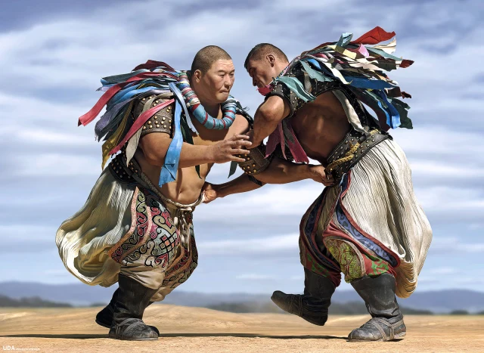
Mongolian Tribes

Slide 9
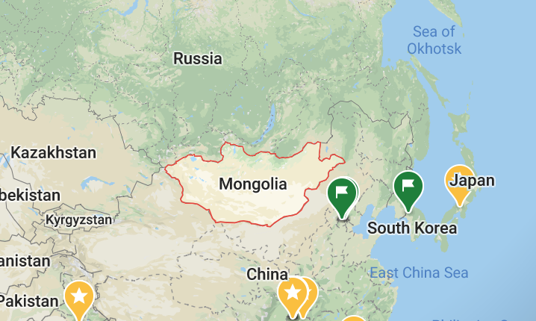

Slide 10
Nomadic Tribes
For nomadic, the most relevant and close synonyms would be:
Itinerant – Refers to traveling from place to place, especially for work or a specific purpose.
Migratory – Refers to moving from one place to another, often in seasonal patterns.
Roaming – Suggests wandering without a fixed direction or purpose, similar to nomadic behavior.
Mobile – Emphasizes the ability to move easily, not fixed in one location.
Wandering – Implies aimless or casual movement, often in search of something or without a set destination

Slide 11
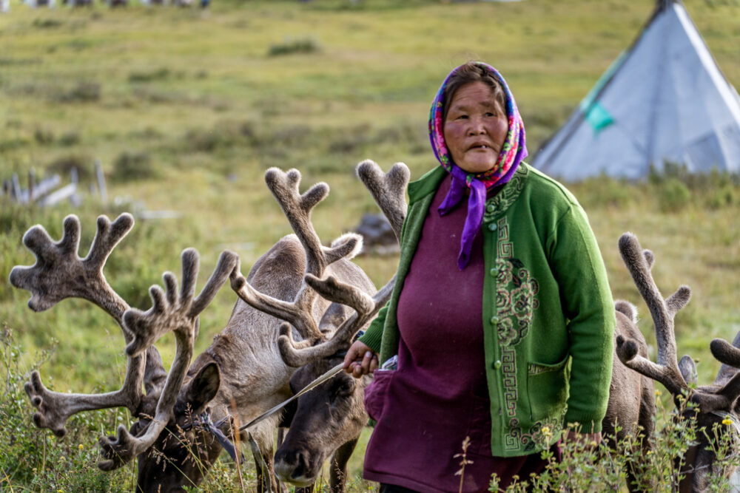

Slide 12
About a third of Mongolia's people are nomads, moving from place to place with no fixed location to call home. They are famous for their distinctive way of dressing, their horses, and the yurts they continue to live in. A typical nomad family has about seven members and follows a seasonal routine. They move four times a year, depending on the availability of resources. Their lifestyle involves raising livestock such as sheep, cattle, and camels. There are many traditions related to nomadic culture. One unique festival only found in Mongolia is Naadam, consisting of sports such as wrestling, horse racing, and archery.

Slide 13
Close Reading Highlighting
When you skim a text, you read through it quickly to get a general sense of the content, rather than reading every word carefully. The idea behind highlighting the important parts is to help you focus on key points or main ideas without getting bogged down in details. This allows you to remember the most relevant information and makes it easier to review the text later.
By highlighting no more than 10% of the text, you're ensuring that you focus on the truly important information, rather than overwhelming yourself with too many details. Skimming followed by selective highlighting helps in processing and retaining the content more efficiently.

Slide 14
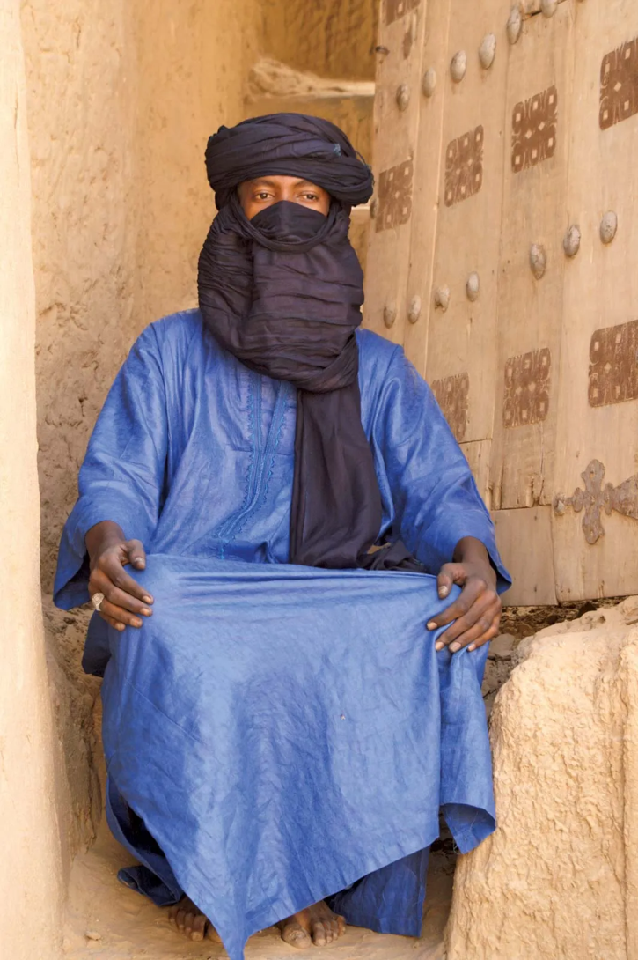
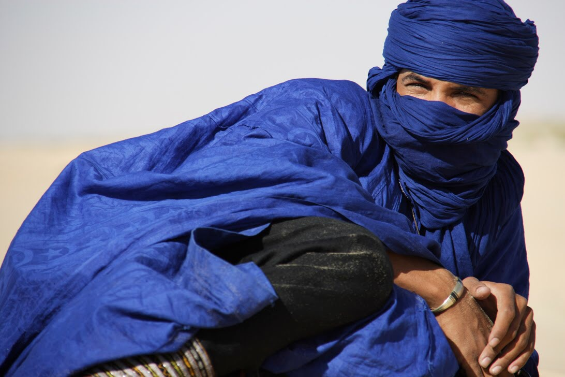
HOME IS WHERE THE HEART IS: Tuareg

Slide 15
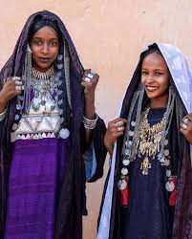

Slide 16
What do you think are the advantages and disadvantages of a nomadic lifestyle?
Advantages:
Close family ties: Since families travel together, they often have strong bonds and spend a lot of time with each other.

Slide 17
Freedom and flexibility: Nomads can move freely and live without being tied down to one location, allowing them to adapt to different environments.
Connection to nature: A nomadic lifestyle often means being in close contact with the natural world, which can lead to a deep understanding and appreciation of the environment.

Slide 18
Disadvantages:
Lack of stability: Moving from place to place can create challenges in terms of finding permanent work, education, and healthcare.

Slide 19
Isolation from the larger community: Nomads may sometimes feel disconnected from urban centers or larger social networks, which can be difficult in the modern world.
Limited resources: Nomadic living can be challenging when it comes to access to basic services and goods, as the lifestyle can be less conducive to regular supply or infrastructure.

Slide 20
Would you like to live a nomadic lifestyle? Why or why not?
I wouldn't like to live a nomadic lifestyle. I think it would be difficult to have a stable routine or career with such constant movement. I value the comforts and stability of a fixed location, like a home, and having access to the amenities and community support that come with it.

Slide 21
Describe the type of lifestyle you think you will have in the future.
For me, the lifestyle that appeals most is one with a balance of stability and flexibility, because it would allow me to enjoy the comforts of a home while still having the ability to travel or explore new places when I choose. I think I’ll aim for a mix of consistency with opportunities for adventure.

Slide 22
Annotation: adding notes to the text
Annotating is a method of actively engaging with a text as you read, which helps you better understand and remember the material. Unlike highlighting, which only marks the text, annotating involves writing notes and reactions directly on the text itself. This helps to deepen comprehension and focus attention on key concepts.

Slide 23
annotating techniques to try:
Underline new vocabulary and write definitions in the margins
Write questions in the margins next to where the answer is found
Circle major claims or important statistics
Put an exclamation mark (!) next to things that you have a strong reaction to
Put a question mark (?) next to things that are unclear, for checking

Slide 24
Quantifiers
Quantifiers are used to indicate the quantity of something. Which quantifier you use depends on whether the noun is singular or plural, and countable or uncountable. It also depends on whether the sentence is positive or negative.

Slide 25
"There is/are + (quantifier) + noun"
This structure is used to show the existence or presence of something in a particular location or situation. It is a common way to talk about what is or isn’t available, or what exists, in a given context. The quantifier inserted between "is/are" and the noun adds more detail about the quantity or amount of the noun being discussed.

Slide 26
1. Singular Count Nouns
When to use it:
Singular count nouns are items that can be counted, but only one of them (e.g., book, meeting, apple).
Structure:
There is + singular count noun
There is + quantifier + singular count noun
Examples:
"There is a meeting today." (There’s one meeting.)
"There is one apple on the table." (It emphasizes the exact number.)

Slide 27
2. Plural Count Nouns
When to use it:
Plural count nouns are things that can be counted in more than one form (e.g., books, chairs, people).
There are + plural count noun
There are + quantifier + plural count noun
Examples:
"There are people in the room." (Indicating the presence of multiple people.)
"There are many people in the room." (Indicating a larger number of people.)
"There are several books on the shelf." (Indicating a few books.)
"There are no cars parked outside." (This tells us there are zero cars.)

Slide 28
3. Non-count Nouns
When to use it:
Non-count nouns are things that cannot be counted individually, often referring to substances, concepts, or collective terms (e.g., water, information, furniture).
There is + noncount noun
There is + quantifier + noncount noun
Examples:
"There is water in the bottle." (Indicating the presence of water, but not counting it directly.)
"There is some information on the desk." (Indicating a portion or amount of information.)
"There is a great deal of furniture in the room." (Indicating a large amount of furniture, without counting individual pieces.)

Slide 29
Quantifiers expressing a large amount
Apart from ‘some’ and ‘any’, there are some quantifiers that can be used for either countable or uncountable nouns, but not both. Let’s have a look at ‘many’ and ‘much’, which express whether there is or isn’t a large amount of something.As in:
I was perturbed that there weren’t many women in the meeting. (Countable)
Many people prefer content that’s optimised for readability. (Countable)
There isn’t much coffee left in the pot. (Uncountable)
You’re making much ado about nothing. (Uncountable)
https://learnenglish.britishcouncil.org/grammar/english-grammar-reference/quantifiers

Slide 30
Questions “ Vocabulary skill”
Here are the definitions of the bold words:
modify = to change or alter something, usually to improve or adjust it.
remotely = from a distance, without being physically present at the location.
suspends = to temporarily stop or pause an activity or operation.

Slide 31
2- Exercise 2
Here are the definitions of the bold words:
range = the distance over which something can operate or be effective.
compatible = able to work or function together without problems or conflict.
evolve = to gradually change or develop over time, usually in a way that improves or adapts to new conditions.

Slide 32
writing
A brainstorming word map is a visual tool used to organize and connect ideas, usually for planning, generating, or expanding on a topic. It helps you visually map out words or concepts that are related to a central idea. It's often used in writing, problem-solving, or any creative task where you need to organize thoughts.

Slide 33
Family map
FAMILY
/ | \
Parents Siblings Activities
/ \ / \ / \
Mom Dad Brother Sister Games vacation \ | | / | | | | |
Cooking Work Engineer Soccer School Movies traveling

Slide 34
Writing Task
Describe your home,100 words at least and write a topic sentence with paying attention to the use of there is/are and quantifiers

