Slide 1



Newspapers- They are the basic source to learn the common English spoken in day to day life. One must read English newspapers daily and practice the words. Read interesting articles…..
Example:
take the Sunday times from the internet read something on-going with the time translate it and try to write something similar about daily-basis life.

Slide 2



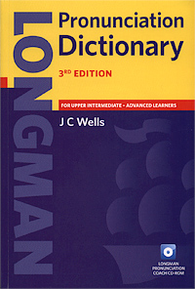
Pocket Dictionary- It is easy to carry a pocket dictionary to any place a person is visiting. Any word that seems difficult or unknown could be referred through dictionary.
Example:
take all kind of dictionary and try to memorize at least 5 words per day…the recommended dictionaries are all the oxford dictionaries, specially the ones with pictures and synonymous dictionaries.

Slide 3


Adopt English in your daily life- If an aspirant wants to be really good in English the only way possible is to use it in daily routine no matter how broken it might seem in starting but with daily routine it will be polished and a rhythm would be created.
Example:
talk to people who speak English enough in your school, using the points, above, chat through the internet, call some friends on the other side of the earth at least 30 minutes per day.

Slide 4


Listen to the English songs- English songs may help you to practice English try and remember the lyrics and practice them.
Example:
Always use easy songs, do not listen to the heavy beat Rock and Roll, just listen to the old jazz and popular music and try to use the sentences they use because these songs are implying from a fine heart.

Slide 5




Watch English Movie- One must watch Hollywood movies for the better reference and if you are unable to understand their language due to fluentness use subtitles.
example
Take the names of these movies and go to Bab-alshaqi market and buy them : rocky….the heat….saving private Ryan…..the end of the world……the lone ranger……the lone survivor…….titanic……god father…….take at least 300 movies watch them every night. Extract the subtitle and imitate them you will find yourself you speak English fluently.

Slide 6

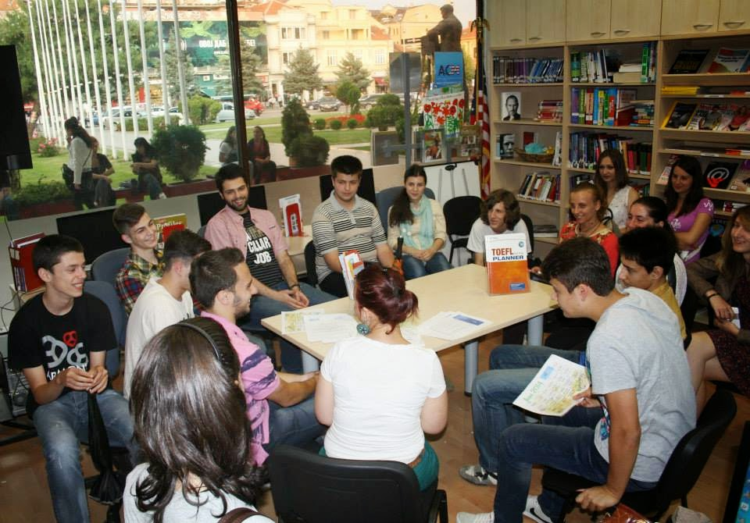

Listen to the conversation attentively- For being a good speaker one must be a good listener too, so be a part of the group speaking in English and listen as well as learn how they are speaking.
Example:
Talk to your teacher, do not be afraid of shamed from him he used to be just like you now. Talk to the students that the over perfect you in English, imitate your teacher the way he walks, talks and speaks and try to recite after him.

Slide 7



Read novel and books- English novels are very supportive in case of spoken language as the conversation given in them are helpful to learn the language.
Example:
Read common language books, short stories, educational material books like merchant of Vince, Oliver Twist and kipps, and try to translate them and tell the story or discuss it with someone else and hit a topic.

Slide 8
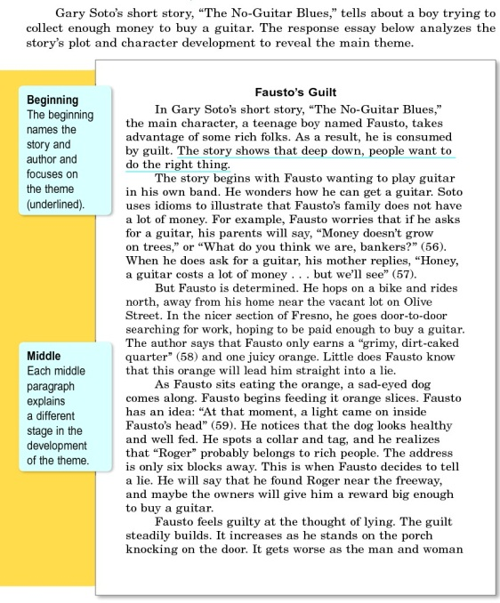

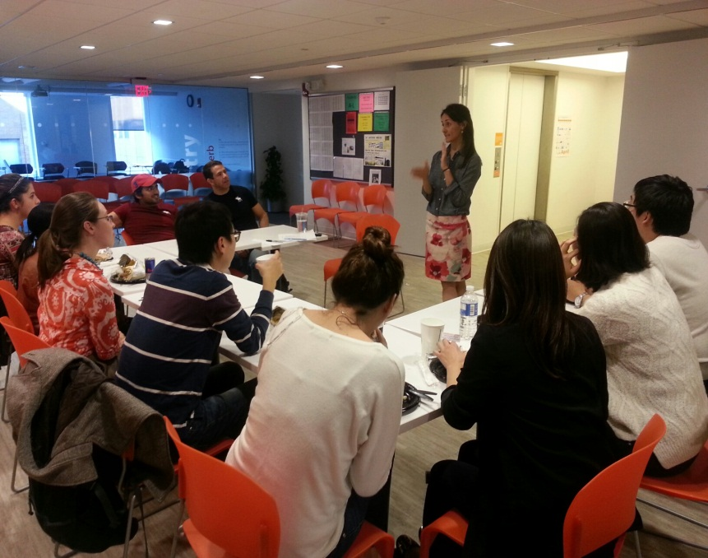
Write in English- Pick a topic and start writing in English about it and then look for the mistakes done while writing it.
Example:
The best example for this as when Mr Wisam, Tariq, Maher, Ali(s) and any one tells you what to do next session try to make a story board and write something and read it by heart and act it like a script in a movie, that way you do not feel alone and strange in the session and not knowing what the hell is going on in the session.

Slide 9
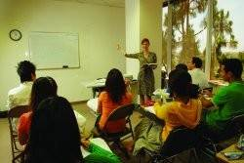


Regular Practice- As there is an English proverb “practice makes the man perfect” so practice it as much as possible, record your voice in English and get your mistakes corrected or you can also join an online spoken English class for the same purpose.
Example:
This means use all the points, mentioned above to speak the English enough to make you communicate, read books and discuss them, watch movie and tell your fiends about, listen to a song and try to sing it after, read commercials, signs, advertisements in the street or TV and try to translate them into English

Slide 10


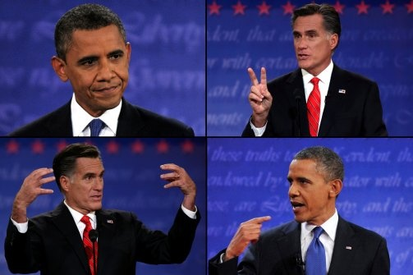





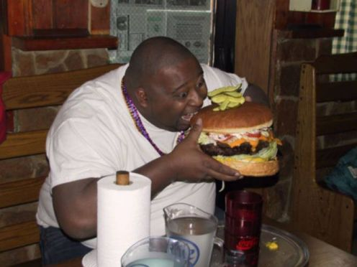







Think in English- choose all the English topics and read, write and talk about

