Slide 1

The Silent Way
presented by
Narjis Abdul-kareem Ismael
University of Diyala\ college of human science
Department of English
Third stage
Class: English language teaching
2025-2026
Notes:
NOTE:
To change the image on this slide, select the picture and delete it. Then click the Pictures icon in the placeholder to insert your own image.

Slide 2
The Silent Way
Developed by Caleb Gattegno
A language teaching method that gives students an active role in learning
The teacher speaks as little as possible
Students are encouraged to discover and produce language independently
Learning emphasizes problem-solving, discovery, and learner autonomy

Slide 3
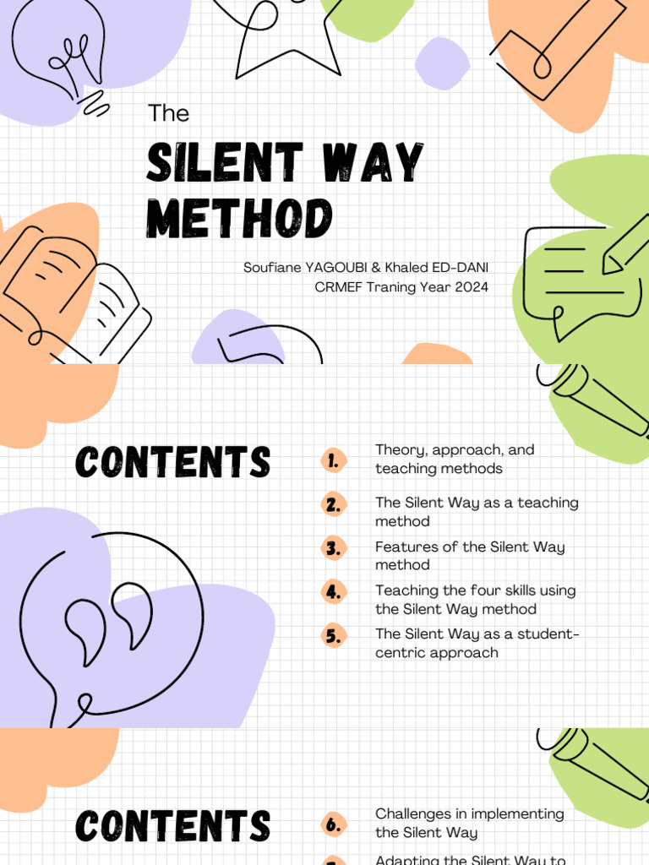
What Is the Silent Way?
Students should be responsible for much of their own learning
The teacher should not do all the talking
Students learn by discovering language rules and patterns
Physical objects and visual materials are used to make language meaningful
Errors are viewed as an important part of learning
Students develop independence and self-confidence

Slide 4
Goals of the Silent Way
Become independent language learners
Develop accurate pronunciation
Communicate effectively in the target language
Discover how the language works
Develop problem-solving skills
Become responsible for their own learning
Use language creatively rather than simply repeat it

Slide 5
Principles of the Silent Way
Teaching should be subordinate to learning
Students should discover rather than simply receive information
The teacher speaks as little as possible
Students should use the target language actively
Mistakes are useful because they show what students need to learn
Learning involves problem-solving
Physical objects can represent sounds, words, and grammatical relationships
Students should develop independence and responsibility

Slide 6
The Role of the Teacher
The teacher:
Speaks as little as possible
Creates situations that encourage students to communicate
Gives clues instead of immediately providing answers
Uses gestures and visual materials
Observes students carefully
Provides feedback without dominating the lesson
Helps students become independent learners
The teacher is mainly a guide and facilitator.

Slide 7
The Role of the Students
Produce language
Discover rules and patterns
Solve language problems
Work with classmates
Correct themselves and each other
Listen carefully
Experiment with language
Take responsibility for their learning
Students are not passive receivers of information.
They are expected to think, explore, and discover.

Slide 8
Materials Used in the Silent Way
Cuisenaire rods
Small colored rods of different lengths
Used to teach vocabulary, grammar, sentence structure, and meaning
Allow students to physically represent language
Sound-Color Chart
Uses colors to represent different sounds
Helps students connect pronunciation with visual symbols
Supports pronunciation practice and self-correction
Word Charts
Help students practice vocabulary and sentence formation
Encourage learners to construct language independently

Slide 9
Advantages and Challenges
Reduces teacher domination of classroom interaction
Challenges
The method can be difficult for inexperienced teachers
Students may initially feel uncomfortable with teacher silence
Some learners may want more direct explanation
Materials such as rods and sound-color charts require preparation
It may be difficult to use effectively with very large classes
Abstract language can sometimes be difficult to represent physically
Slide 10 — Conclusion
The Silent Way in Summary
Reduces teacher domination of classroom interaction
Challenges
The method can be difficult for inexperienced teachers
Students may initially feel uncomfortable with teacher silence
Some learners may want more direct explanation
Materials such as rods and sound-color charts require preparation
It may be difficult to use effectively with very large classes
Abstract language can sometimes be difficult to represent physically
Slide 10 — Conclusion
The Silent Way in Summary
Advantages
Encourages learner independence
Gives students substantial opportunities to speak
Promotes active learning
Develops problem-solving skills
Encourages self-correction
Can increase students' awareness of language
Reduces teacher domination of classroom interaction
Challenges
The method can be difficult for inexperienced teachers
Students may initially feel uncomfortable with teacher silence
Some learners may want more direct explanation
Materials such as rods and sound-color charts require preparation
It may be difficult to use effectively with very large classes
Abstract language can sometimes be difficult to represent physically

Slide 10
Discussion Question:
Why might teacher silence encourage students to become more independent language learners?

Slide 11


