Slide 1

Desuggestopedia
presented by
Narjis Abdul-kareem Ismael
University of Diyala\ college of human science
Department of English
Third stage
Class: English language teaching
2025-2026
Notes:
NOTE:
To change the image on this slide, select the picture and delete it. Then click the Pictures icon in the placeholder to insert your own image.

Slide 2
Desuggestopedia
Developed by Georgi Lozanov
Originally associated with the name Suggestopedia
Focuses on removing psychological barriers to language learning
Creates a relaxed and comfortable learning environment
Uses music, art, classroom atmosphere, and positive suggestion

Slide 3
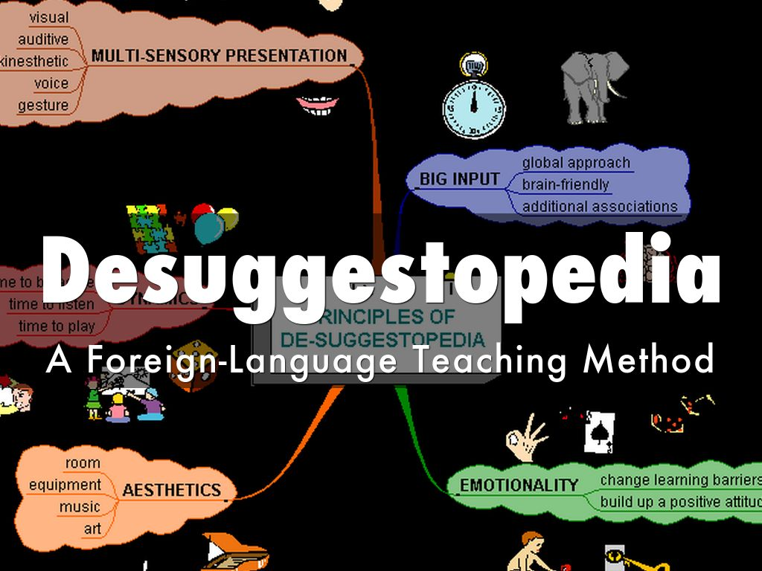
What Is Desuggestopedia?
Students may have psychological barriers that affect learning
A relaxed classroom can help students learn more effectively
Students should feel confident and comfortable
Music and a pleasant environment are important
Learning can involve both conscious and less-conscious processes
The teacher creates a supportive and positive atmosphere

Slide 4
Goals of Desuggestopedia
earn a large amount of language material
Communicate in the target language
Reduce anxiety and fear of making mistakes
Develop confidence
Improve vocabulary and speaking ability
Participate in an enjoyable learning environment
Use language naturally and creatively

Slide 5
Principles of Desuggestopedia
Learning should take place in a relaxed atmosphere
Students should feel secure and confident
Positive suggestion can support learning
Music can contribute to the learning environment
The classroom should be comfortable and attractive
Communication is important
Students learn through meaningful and interesting activities
Mistakes are not treated as something that should create fear
Both conscious and less-conscious learning processes are considered

Slide 6
The Role of the Teacher
Creates a comfortable and supportive classroom
Builds students' confidence
Presents language enthusiastically
Uses music and appropriate classroom activities
Provides positive encouragement
Maintains a friendly relationship with students
Acts as a model for communication
Helps students overcome negative expectations about learning
The teacher's attitude is an important part of the method.

Slide 7
The Role of the Students
Participate actively in classroom activities
Listen and communicate in the target language
Become comfortable using the language
Take part in role-plays and conversations
Read and interact with texts
Avoid excessive fear of making mistakes
Respond positively to classroom activities
Develop confidence in their ability to learn
The goal is to create learners who are relaxed, confident, and willing to communicate.

Slide 8
The Classroom Environment
Comfortable seating
Attractive decorations
Posters or displays containing language information
Soft or classical music
A pleasant and relaxed atmosphere
Activities that encourage students to feel comfortable

Slide 9
Major Techniques
Peripheral learning: Language information is displayed around the classroom so students can absorb it indirectly.
Positive suggestion: The teacher creates confidence and reduces students' fear of failure.
Concert sessions: Language texts are presented while music is used to create a particular atmosphere.
Role play: Students act out situations using the target language.
Games: Games make practice enjoyable and reduce tension.
Songs and music: Music is used to support the learning experience.
Reading aloud: Students practice language through expressive reading.

Slide 10
Advantages and Challenges
Advantages
Creates a relaxed learning environment
Can reduce students' anxiety
Encourages confidence
Makes language learning enjoyable
Provides opportunities for communication
Uses varied activities and materials
Can make students more willing to participate
Challenges
Requires a suitable classroom environment
Some students may feel uncomfortable with unusual activities
Music and relaxation techniques may not work equally well for everyone
Teachers need training and confidence to use the method effectively
Some techniques may be difficult in large classes
The approach can require considerable preparation

Slide 11
How can a teacher create a classroom environment that reduces students' anxiety about learning a foreign language?

Slide 12


