Slide 1

Communicative Language Teaching (CLT)
presented by
Narjis Abdul-kareem Ismael
University of Diyala\ college of human science
Department of English
Third stage
Class: English language teaching
2025-2026
Notes:
NOTE:
To change the image on this slide, select the picture and delete it. Then click the Pictures icon in the placeholder to insert your own image.

Slide 2
Communicative Language Teaching (CLT)
Focuses on using language for meaningful communication
Emphasizes communication rather than only learning grammar rules
Students learn by using language in realistic situations
Fluency and meaningful interaction are important
Grammar remains important, but it is taught in connection with communication

Slide 3
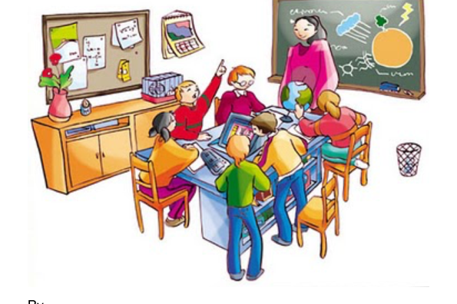
What Is Communicative Language Teaching (CLT)?
Communicate meaningfully
Use language in different situations
Understand and express messages
Interact with other people
Choose appropriate language for different contexts
Use communication strategies when they do not know an exact word or expression

Slide 4
Goals of CLT
Develop communicative competence
Improve speaking and listening
Develop reading and writing skills
Communicate meaning effectively
Use language appropriately in different situations
Develop fluency and accuracy
Become confident communicators
Use communication strategies

Slide 5
Principles of CLT
Language is primarily a tool for communication.
Communication should involve meaningful messages.
Students should have opportunities to interact with one another.
Fluency is important, as well as accuracy.
Classroom activities should resemble real communication when possible.
Students learn from using language, not only from studying rules.
Errors can be a natural part of communication and learning.
Different language skills can be integrated.
Context is important when learning language.

Slide 6
The Role of the Teacher
Facilitates communication
Creates opportunities for interaction
Provides language support
Organizes pair and group activities
Monitors students' communication
Provides feedback
Helps students develop communication strategies
Acts as a resource when students need assistance

Slide 7
The Role of the Students
Communicate with classmates
Work in pairs and groups
Exchange information
Express their own opinions and ideas
Solve problems using language
Negotiate meaning
Take responsibility for their learning
Practice both fluency and accuracy

Slide 8
Major Techniques
Authentic materials: Students work with real-world texts, advertisements, menus, schedules, or other materials.
Scrambled sentences: Students organize sentences or passages into a logical order.
Language games: Games encourage meaningful communication.
Picture strip stories: Students create or tell stories using pictures.
Role play: Students act out realistic situations.
Information-gap activities: Students have different information and must communicate to complete a task.
Pair and group work: Students interact with several classmates.

Slide 9
Advantages and Challenges
Advantages
Provides meaningful communication practice
Develops fluency
Encourages student interaction
Connects classroom learning with real-life communication
Increases student participation
Develops communication strategies
Integrates different language skills
Challenges
Classroom management can be more difficult
Some students may make frequent grammatical errors during communication
Large classes can make interaction difficult
Teachers need to balance fluency and accuracy
Assessment of communicative ability can be challenging
Students accustomed to traditional teaching may need time to adapt

Slide 10
What is the difference between knowing English grammar and being able to communicate effectively in English?

Slide 11


