Slide 1

The Audio-Lingual Method
presented by
Narjis Abdul-kareem Ismael
University of Diyala\ college of human science
Department of English
Third stage
Class: English language teaching
2025-2026
Notes:
NOTE:
To change the image on this slide, select the picture and delete it. Then click the Pictures icon in the placeholder to insert your own image.

Slide 2
The Audio-Lingual Method
Developed strongly in the United States during the 1940s and 1950s
Influenced by structural linguistics and behaviorist psychology
Gives strong emphasis to listening and speaking
Language is learned through patterns, practice, and repetition
Students develop habits through intensive oral practice

Slide 3
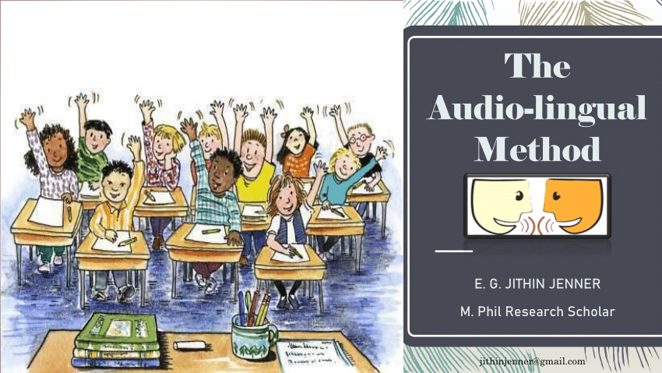
What Is the Audio-Lingual Method?
Listening before reading and writing
Speaking and pronunciation
Memorization of dialogues
Repetition and pattern practice
Learning grammatical structures through practice
Developing correct language habits

Slide 4
Goals of the Audio-Lingual Method
Communicate in the target language
Develop accurate pronunciation
Understand spoken language
Produce correct grammatical patterns
Develop automatic language habits
Respond quickly and accurately
Learn the structural patterns of the target language

Slide 5
Principles of the Audio-Lingual Method
Language is primarily spoken.
Listening and speaking come before reading and writing.
Language learning involves habit formation.
New vocabulary and structures are introduced through dialogues.
Students practice language patterns repeatedly.
Errors should be minimized because they may lead to incorrect habits.
Grammar is taught through examples and patterns rather than long explanations.
The teacher provides a model that students imitate.

Slide 6
The Role of the Teacher
Provides a correct model of the target language
Presents dialogues
Controls the practice activities
Gives clear instructions
Conducts drills
Corrects errors immediately
Controls the pace of the lesson
Provides reinforcement for correct responses

Slide 7
The Role of the Students
Listen carefully
Imitate the teacher
Memorize dialogues
Repeat language patterns
Respond quickly to prompts
Practice pronunciation
Complete drills
Avoid unnecessary errors

Slide 8
Major Audio-Lingual Techniques
Dialog memorization: Students memorize and perform conversations.
Repetition drill: Students repeat a model provided by the teacher.
Substitution drill: Students replace one part of a sentence with another word or phrase.
Question-and-answer drill: Students respond to questions using a specific pattern.
Chain drill: Students ask and answer questions around the classroom.
Transformation drill: Students change sentences according to a model.
Completion drill: Students complete an unfinished sentence.
Minimal-pair practice: Students practice distinguishing similar sounds.

Slide 9
Advantages and Challenges
Advantages
Provides extensive speaking practice
Develops pronunciation
Gives students intensive practice with language patterns
Can help beginning learners produce basic structures
Provides clear and organized practice
Gives students frequent opportunities to hear the target language
Can help students develop automatic responses
Challenges
Repetition can become monotonous
Students may have limited opportunities for creative communication
Focus on accuracy may reduce attention to meaning
Students may depend heavily on memorized patterns
Errors are sometimes treated too negatively
Communication outside practiced patterns may be difficult
The method can provide less opportunity for spontaneous interaction

Slide 10
Do students learn to communicate effectively just by repeating language patterns? Why or why not?

Slide 11


