Slide 1

University of Diyala
College of Education for Humanities
Department of English
Linguistics/Fourth Grade
Assist.Inst.Reham.Abdul-Kareem

Slide 2
Language and the Brain
What is language?
Language is a system of communication that involves the use of symbols, sounds, and gestures to convey meaning.
The importance of studying language and the brain:
Understanding how the brain processes language helps us uncover insights into cognitive abilities, communication disorders, and language learning.
Key question:
How does the brain manage the complex task of acquiring, processing, and producing language?

Slide 3
Neurolinguistics:
The study of the relationship between language and the brain is called neurolinguistics. Although this is a relatively recent term, the field of study dates back to the nineteenth century.
Importance of Neurolinguistics:
1.Understanding Brain-Language Relationship : Neurolinguistics helps us understand how different areas of the brain contribute to language functions like speaking, understanding, reading, and writing. This knowledge helps in mapping out the brain’s language centers, such as Broca's and Wernicke's areas.
2.Diagnosis and Treatment of Language Disorders : Neurolinguistics plays a crucial role in diagnosing and treating aphasia, dyslexia, stuttering, and other speech or language impairments.

Slide 4
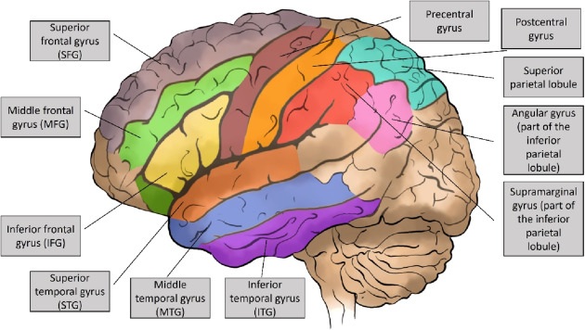

Slide 5
The Role of Hemispheres in Language
Left Hemisphere:
Typically dominates language processing. It handles grammar, vocabulary, and sentence structure. This is why most people have language centers in the left hemisphere.
Right Hemisphere:
More involved in processing prosody (intonation), metaphors, humor, and figurative language. It helps interpret the emotional tone and deeper meanings behind words.

Slide 6
The brain has several specialized regions involved in language processing. These areas work together to enable speaking, understanding, reading, and writing. Here are the key brain structures involved in language:
1. Broca’s Area Location: Left frontal lobe (usually in the left hemisphere). Function: Language production, speech planning, and grammar processing. Damage leads to: Broca’s aphasia – characterized by slow, labored speech with relatively preserved comprehension.
2. Wernicke’s Area Location: Left temporal lobe (posterior part of the superior temporal gyrus). Function: Language comprehension (understanding spoken and written language). Damage leads to: Wernicke’s aphasia – fluent but nonsensical speech and poor comprehension.
3. Arcuate Fasciculus Location: A bundle of nerve fibers connecting Broca’s and Wernicke’s areas .Function: Facilitates communication between language production and comprehension areas. Damage leads to: Conduction aphasia – difficulty repeating words despite good comprehension and fluent speech.

Slide 7
Language Disorders and the Brain:
Aphasia is a language disorder caused by damage to specific areas of the brain that are responsible for language. It affects the ability to speak, understand, read, or write, depending on the type and location of the brain damage.
Causes of Aphasia:
Stroke (most common cause)
Traumatic brain injury (TBI)
Brain tumors
Infections
Neurodegenerative diseases (e.g., primary progressive aphasia)

Slide 8
Brain Regions Involved
Aphasia typically results from damage to the left hemisphere, which is dominant for language in most people. Key areas include:
Broca’s Area → speech production
Wernicke’s Area → language comprehension
Arcuate Fasciculus → connects Broca’s and Wernicke’s areas
Angular and Supramarginal Gyri → reading, writing, and phonological processing

Slide 9
Thank You

