Slide 1
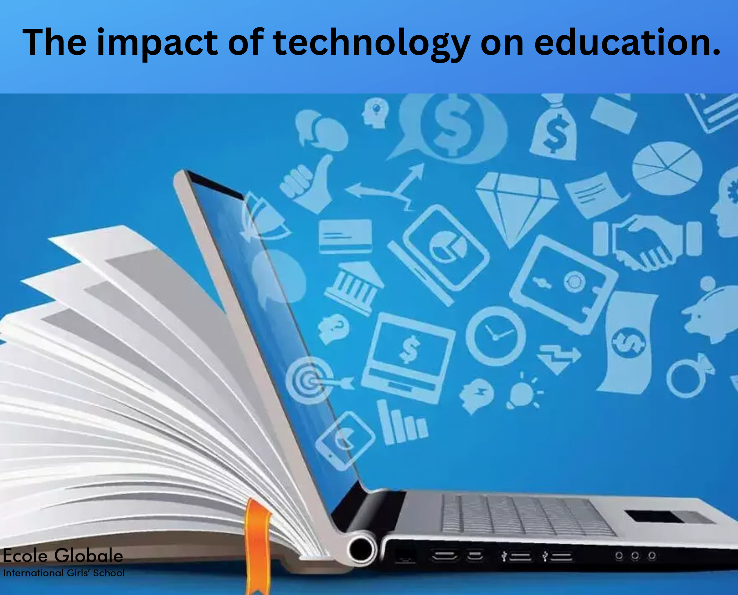
educational technology
COMMUNICATION TECHNOLOGY
presented by
Asst.Inst. Narjis Abdul-kareem Ismael
University of Diyala\ college of human science
Department of English
Third stage
Class: English language teaching
2026-2027
Notes:
NOTE:
To change the image on this slide, select the picture and delete it. Then click the Pictures icon in the placeholder to insert your own image.

Slide 2
COMMUNICATION meanings
Communication is that process in which people try to exchange views to each other through general awareness
mutual exchange of information and ideas.
a process of conveying ideas, exchanging, conveying your points to others and listening to others, facts, attitudes, emotions and exchanging information and knowledge.
a dynamic process in which a person influences the equipment and resources in terms of consciousness, unconsciousness and signs of cognitive structure of others such as gestures etc.

Slide 3
COMMUNICATION meanings
process in which two or more person mutually exchange ideas, facts, feelings etc. in such a way that everyone understands it. Sender and receiver coordinate by means of messages.
process which changes the ideas, opinions and attitudes of people by using information, instructions and decision under the social system.
sharing of ideas and feelings in a mood of mutuality.” Three simple but important definition of communication are being given below
Communication is the process by which an idea is transferred from a source to a receiver with the intention of changing his behaviour.
It is a mutual exchange of facts, thought or perceptions leading to a common understanding of all parties. It does not necessarily imply agreement

Slide 4
Nature and Characteristics of Communication
Mutual Relationship
Exchange of Ideas
Two-Way Process
Objective Process
Psychological and Social Aspects
Effective Learning
Perception
Information vs. Communication
Individual Differences
Social Environment
Four Main Tasks
Interaction
Different Forms
Dynamic Process
For more details check page 21-22

Slide 5
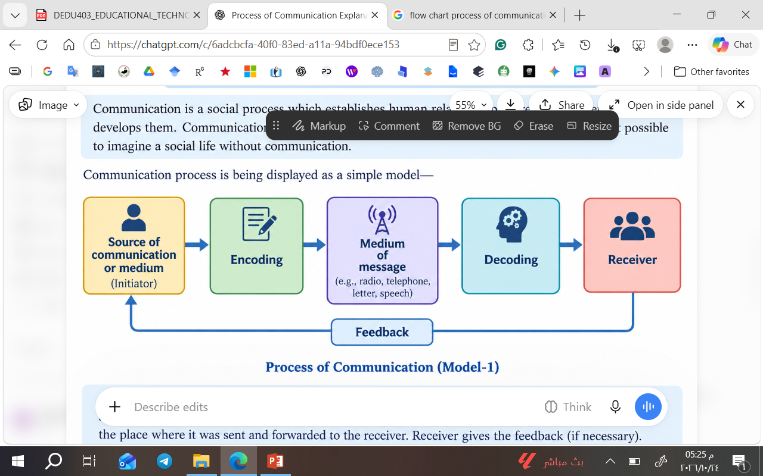
Process of Communication

Slide 6
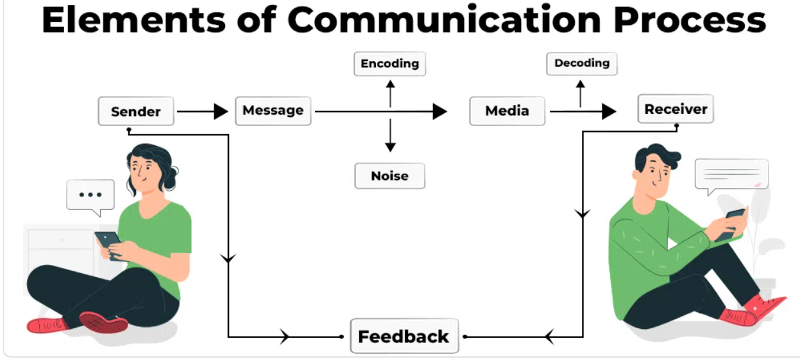

Slide 7
Educational Communication and Public Communication
Educational communication
Public Communication
Achieve learning goals.
Teachers and students.
Speech and teaching aids.
Mostly two-way.
From students.
Classroom teaching.
Share public information
Organizations and the public..
TV, radio, newspapers.
Often one-way.
From the audience.
TV news broadcast.
For more details check page 26

Slide 8
Referencess
Pal, K. (Ed.). (n.d.). Educational technology

Slide 9


